Slide 1

Query-Driven On-The-Fly Knowledge Base Construction
EPL646: Advanced Topics in Databases
Query-Driven On-The-Fly Knowledge Base Construction. Dat Ba Nguyen, Abdalghani Abujabal, Khanh Tran, Martin Theobald, Gerhard Weikum: 66-79, Volume 11, Number 1, September 2017, PVLDB 2017.
By: Maria Igarievna Maslioukova (migari01@cs.ucy.ac.cy)

Slide 2
Presentation Outline
Motivation
QKBﬂy Design
Semantic Graph
Graph Densification Algorithm
Canonicalization
Experiments
Conclusions and Future Work

Slide 3
Knowledge Base
A knowledge base (KB) is a technology used to store complex structured and unstructured information used by a computer system. A knowledge-based system consists of a knowledge-base that represents facts about the world and an inference engine that can reason about those facts and use rules and other forms of logic to deduce new facts or highlight inconsistencies.
-Wikipedia

Slide 4
Motivation
State of the art KBs
(Dbpedia [2], Yago [3], Wikidata [4], Freebase [5], OpenIE [8], DeepDive [6], DEFIE [7], etc.)
QKBﬂy
capture billions of facts about world’s entities
limited in up-to-date coverage (what happens now in the world)
don’t capture relationships among entities (ex. has_adopted_child, filed_divorce_from )
don’t apply synonym substitution (“Brad Pitt”, “Bradley Pitt”, “Oscar winner Pitt”)
for advance extractions speciﬁcations of predicates and rules are required (high overhead)
acquire facts for a much larger set of predicates
capture ternary and higher-arity predicates
query-driven (entity-centric query or a natural language question)
question answering on emerging topics (on-the-ﬂy KB)
novel graph-based approach for cleaning, canonicalizing and organizing noisy extractions

Slide 5
Presentation Outline
Motivation
QKBﬂy Design
Semantic Graph
Graph Densification Algorithm
Canonicalization
Experiments
Conclusions and Future Work

Slide 6
KB Priorities
Precision: fraction of correct tuples among the acquired ones
Recall: fraction of correct tuples among the ones that could possibly be acquired from the input
on-the-ﬂy KB
recall-oriented extraction
precision-oriented cleaning

Slide 7
QKBﬂy Design
Extraction: Linguistic pre-processing is used for handling the high diversity of input documents. (Specific tools for decomposing sentences into a set of clauses.)
Cleaning: Remove false positives and semantic redundancy. The first by resolving entity mentions and co-references, and the second by canonicalizing relational predicates. (Transformed to a weighted MaxSat problem).

Slide 8
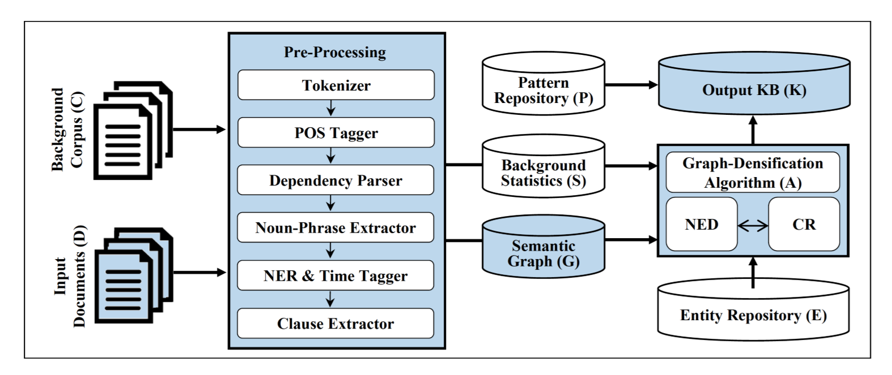
QKBﬂy Architecture
3) Canonicalization (merge co-references and paraphrase mapping )
2) Graph-densification (entity disambiguation and co-reference resolution)
1) Build semantic graph from clauses in input documents

Slide 9

Static input
Background Repositories: The background corpus (C) (Wikipedia full-text dump), the relational paraphrase repository (P) (PATTY [10]) and the entity repository (E) (Yago[3], with their gender attributes for better pronoun resolution). From (C), background statistics (S) are extracted.
Statistics: Pre-processing linguistic tools, consisting of tokenization, part-of-speech (POS) tagging, noun-phrase chunking and named-entity recognition (NER), time tagging and ClausIE [9]. The Wikipedia-based corpus (C) clause components are mapped to Wikipedia entities by their href links. Finally (co-)occurrence statistics for clause-argument-types and the relationships among them are computed.

Slide 10
Presentation Outline
Motivation
QKBﬂy Design
Semantic Graph
Graph Densification Algorithm
Canonicalization
Experiments
Conclusions and Future Work

Slide 11
Semantic Graph
A semantic graph is created for every sentence in the input. A leaf node in this graph represents an occurrence of an entity, while an edge among two leaf nodes represents their relation. The per-sentence graphs are linked so that potentially the leaf nodes refer to the same entity.

Slide 12
Graph Components
Nodes
Edges
Clause node is generated for each detected clause. A clause may be connected to multiple dependent clauses in the same sentence.
Noun-phrase node is generated for each noun phrase detected by the noun-phrase chunker and for each named entity.
Pronoun node is generated for a pronoun (such as “he”, “she”, etc.).
Entity node is generated for each noun-phrase (e.g., Brad Pitt) that is matched in the entity repository.
Depends edge links two dependent clauses. It links a clause node with the noun-phrase and pronoun nodes it contains.
Relation edge represents a relation that connects two noun-phrase or pronoun nodes (i.e., preposition such as “to”, “in”, etc.). Also, patterns of the form “ ’s noun” (e.g., “Pitt’s ex-wife Angelina Jolie).
SameAs edge links two noun-phrase or pronoun nodes which refer to the same entity. For clauses with the same label (e.g., PERSON), string matching is used to determine their similarity (e.g., “Brad Pitt” and “Pitt”).
Means edge links a noun-phrase or pronoun node with an entity node in the entity repository.

Slide 13
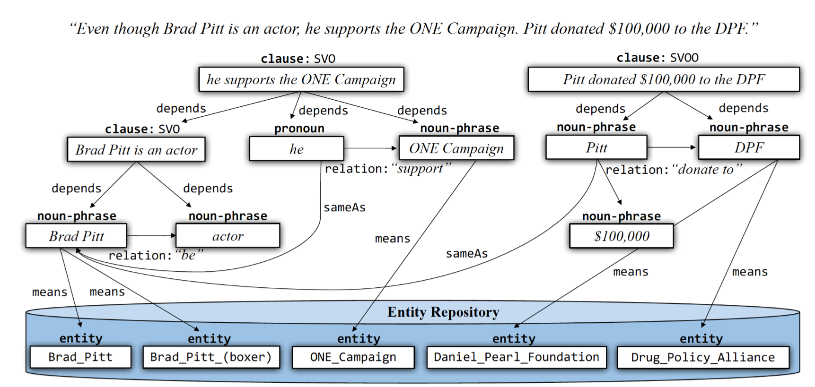
Example

Slide 14
Presentation Outline
Motivation
QKBﬂy Design
Semantic Graph
Graph Densification Algorithm
Canonicalization
Experiments
Conclusions and Future Work

Slide 15
Graph Densification Algorithm
The semantic graph built according to the previous section will be mentioned as G =(N,R), where N is the set of nodes and R the set of edges (i.e., “relationships”).
Goal:
Remove false-positive means and sameAs edges by solving a constraint-based optimization problem.
Tool:
A joint inference for the named-entity disambiguation (NED) and co-reference resolution (CR).

Slide 16
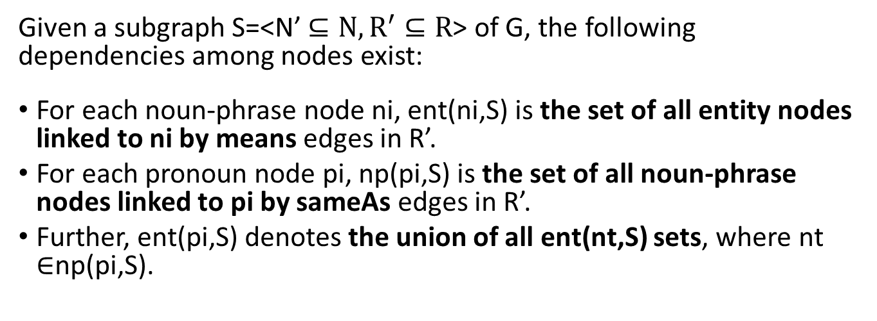
Edge Weights
Given a subgraph S=<N’ $⊆N, R^{′}⊆R$> of G, the following dependencies among nodes exist:
For each noun-phrase node ni, ent(ni,S) is the set of all entity nodes linked to ni by means edges in R’.
For each pronoun node pi, np(pi,S) is the set of all noun-phrase nodes linked to pi by sameAs edges in R’.
Further, ent(pi,S) denotes the union of all ent(nt,S) sets, where nt $∈$np(pi,S).

Slide 17
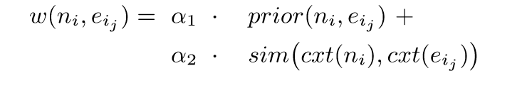
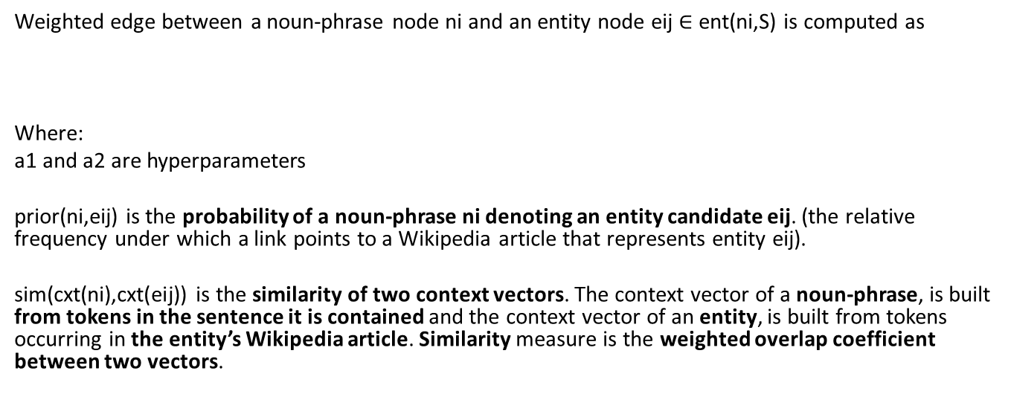
Weight of a Means Edge
Weighted edge between a noun-phrase node ni and an entity node eij $∈$ ent(ni,S) is computed as
Where:
a1 and a2 are hyperparameters
prior(ni,eij) is the probability of a noun-phrase ni denoting an entity candidate eij. (the relative frequency under which a link points to a Wikipedia article that represents entity eij).
sim(cxt(ni),cxt(eij)) is the similarity of two context vectors. The context vector of a noun-phrase, is built from tokens in the sentence it is contained and the context vector of an entity, is built from tokens occurring in the entity’s Wikipedia article. Similarity measure is the weighted overlap coefficient between two vectors.

Slide 18
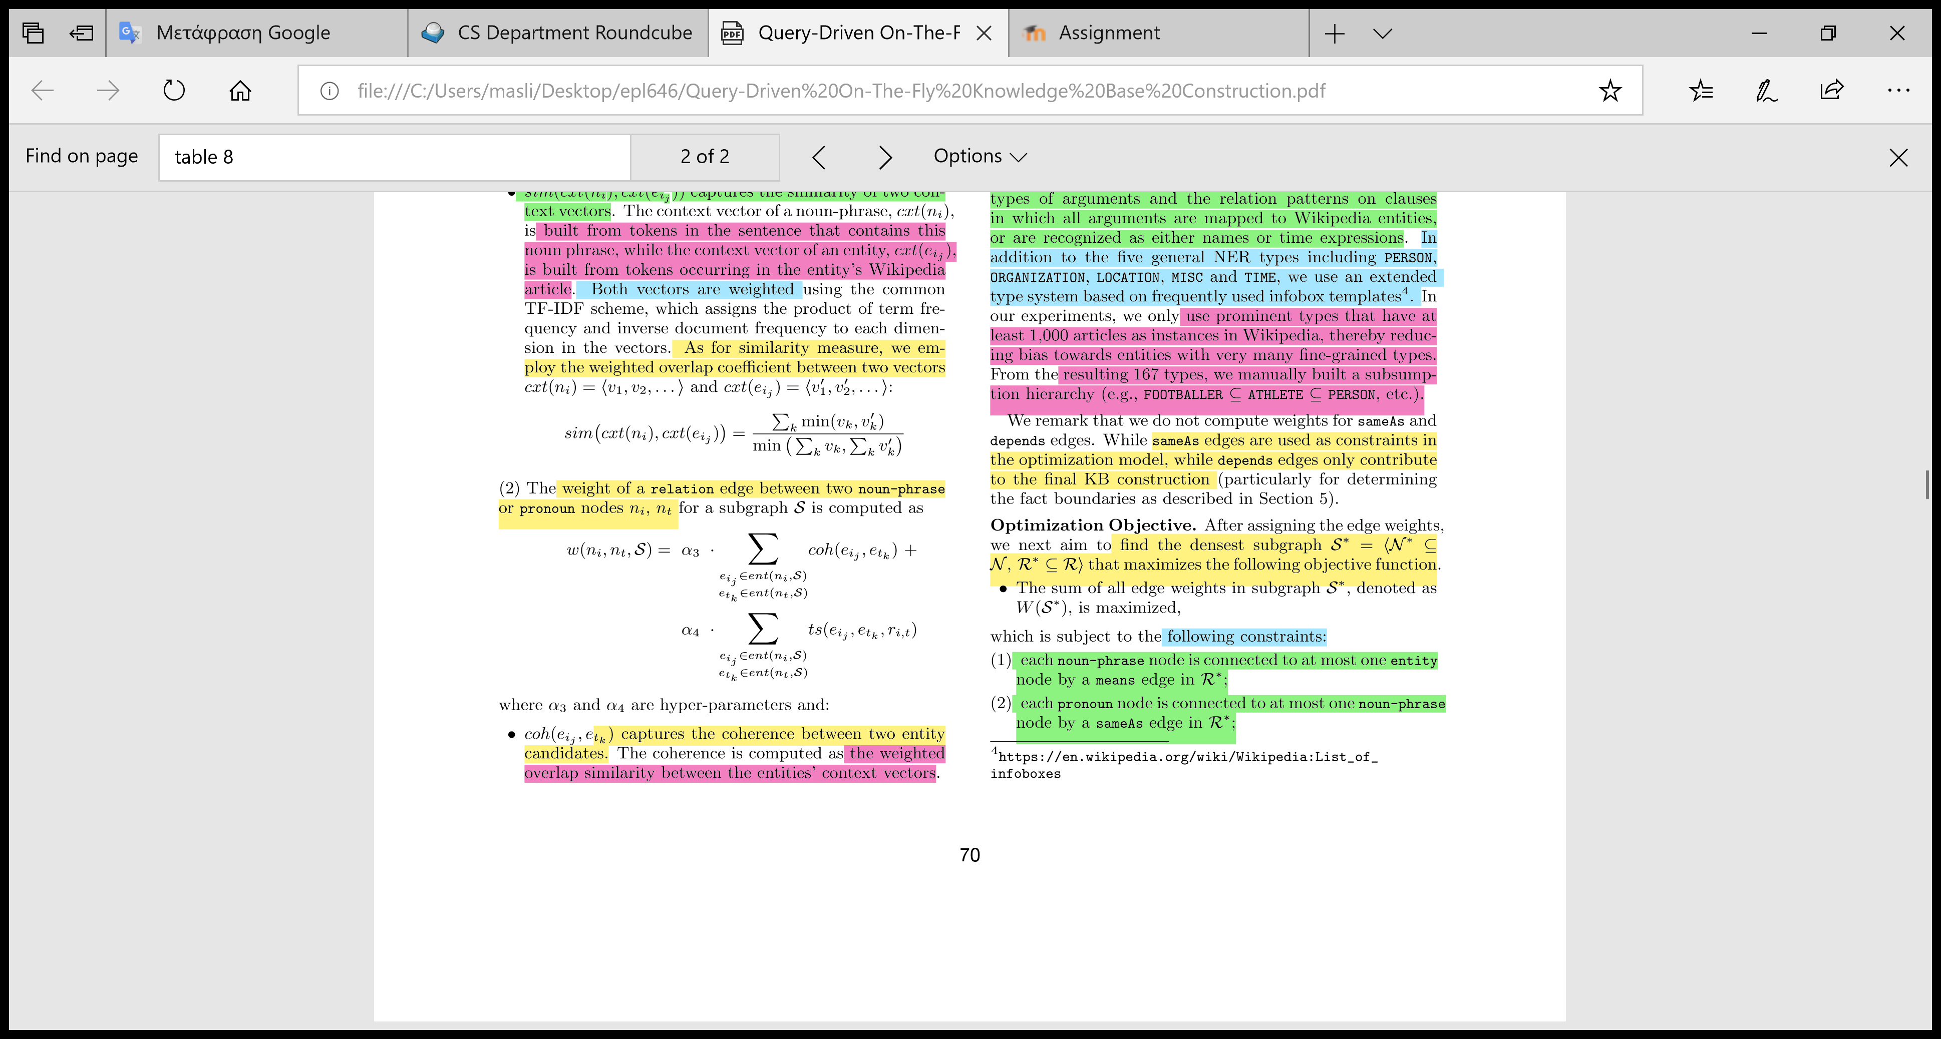
Weight of a Relation Edge
Weighted edge between two noun-phrase or pronoun nodes ni, nt is computed as
Where:
a3 and a4 are hyperparameters
coh(eij,etk): is the coherence between two entity candidates (the weighted overlap similarity between the entities’ context vectors).
ts(eij,etk,ri,t): is the relative frequency under which the semantic types of eij,etk occur under the relation pattern ri,t in the clause set (all type combinations are summed, since an entity can have several types ).

Slide 19
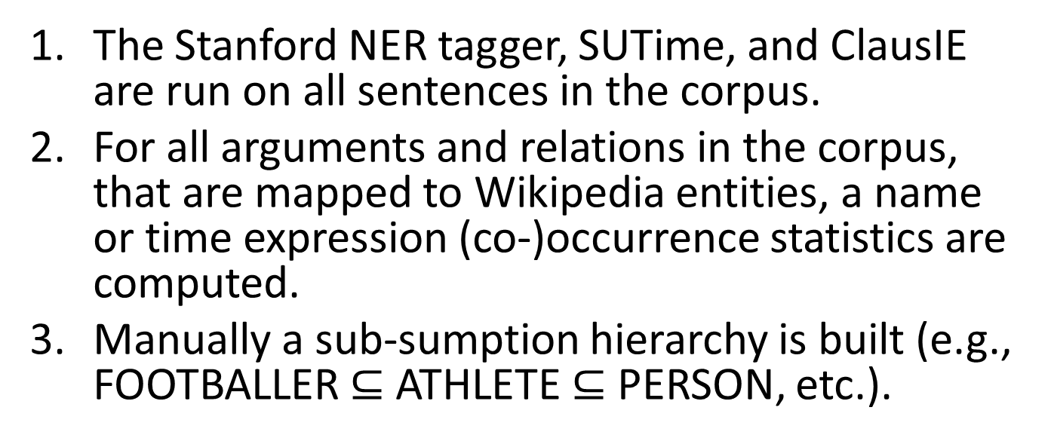
Type Signatures
The Stanford NER tagger, SUTime, and ClausIE are run on all sentences in the corpus.
For all arguments and relations in the corpus, that are mapped to Wikipedia entities, a name or time expression (co-)occurrence statistics are computed.
Manually a sub-sumption hierarchy is built (e.g., FOOTBALLER $⊆$ ATHLETE $⊆$ PERSON, etc.).

Slide 20
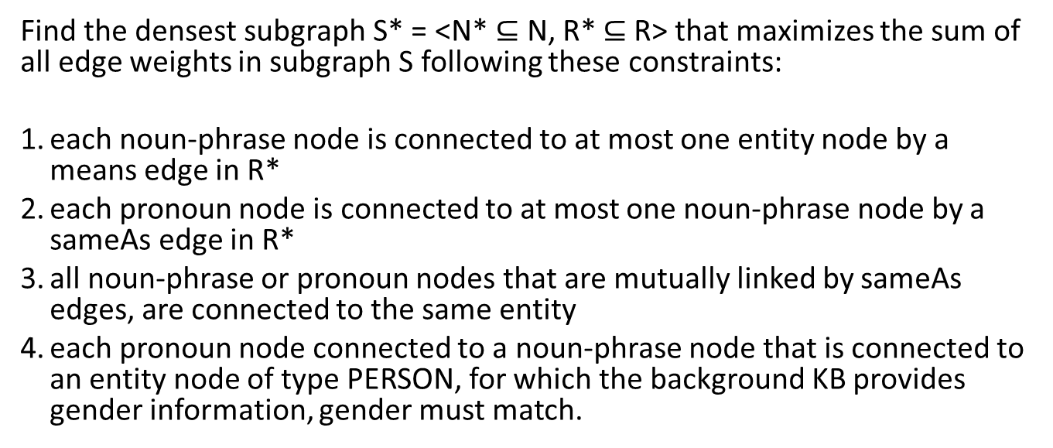
Optimization Objective
Find the densest subgraph S* = <N* $⊆$ N, R* $⊆$R> that maximizes the sum of all edge weights in subgraph S following these constraints:
each noun-phrase node is connected to at most one entity node by a means edge in R*
each pronoun node is connected to at most one noun-phrase node by a sameAs edge in R*
all noun-phrase or pronoun nodes that are mutually linked by sameAs edges, are connected to the same entity
each pronoun node connected to a noun-phrase node that is connected to an entity node of type PERSON, for which the background KB provides gender information, gender must match.

Slide 21
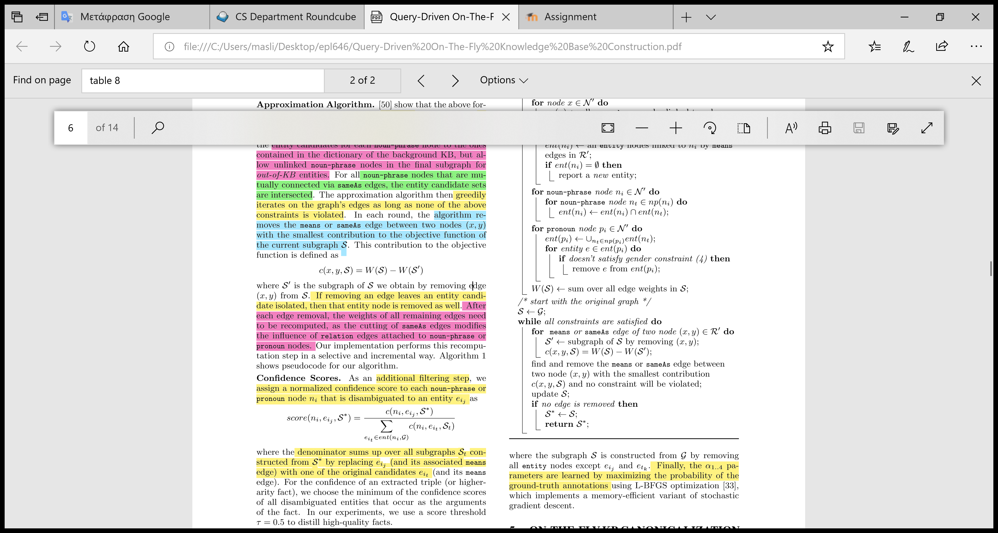
Approximation Algorithm
Constraint problem solving is NP-hard, thus a greedy algorithm is adopted as an approximation of the optimization objective by the following greedy algorithm.
Algorithm:
Entity candidates must appear in the dictionary of the background KB or are unlinked noun-phrase nodes in the ﬁnal subgraph (out-of-KB entities).
All noun-phrase nodes that are mutually connected via sameAs edges their entity candidate sets are intersected.
Iterate over graph’s edges as long as none of the 4 constraints are violated (or no edges were removed)
Remove means or sameAs edge between two nodes with the smallest contribution to the objective function of the current subgraph S.
If removing an edge leaves an entity candidate isolated, then that entity node is removed.
Recompute the weights of all remaining edges (sameAs edges modiﬁes the inﬂuence of relation edges).

Slide 22
Conﬁdence Scores
Additional ﬁltering step, where a normalized conﬁdence score is assigned to each noun-phrase or pronoun node ni that is disambiguated to an entity eij as
where the denominator is the sum of all subgraphs St constructed from S* by replacing eij (and its associated means edge) with one of the original candidates eit (and its means edge). The conﬁdence score is the minimum of the conﬁdence scores of all disambiguated entities that occur in that fact.

Slide 23
Hyper-Parameter Tuning
162 sentences were manually annotated from 5 Wikipedia articles covering scientists, politicians, sports stars, business people and models.
Annotation resulted in 203 facts, each consisting of an emerging entity and a relation pattern (e.g.,<Larry Page, “born in”, Michigan>).
A graph G is constructed for each extracted fact, with a probability of choosing that fact as where the subgraph S will be constructed.
Finally, the hyperparameters are learned by maximizing the probability of the ground-truth annotations using L-BFGS optimization (a memory-efficient variant of stochastic gradient descent).

Slide 24
Presentation Outline
Motivation
QKBﬂy Design
Semantic Graph
Graph Densification Algorithm
Canonicalization
Experiments
Conclusions and Future Work

Slide 25
Canonicalization
on-the-fly facts
A node is either in the entity repository (or connected with a node in the repository via sameAs edge), either has low confidence scores belonging to the repository making it a new entity (up-to-date knowledge).
Nodes with the same label and edge labels that belong to the same synonym set (PATTY [10]) are combined into a single triple. (e.g “play in”, “act in” and “star in”).
Ternary or higher-arity relations are constructed when ever noun-phrase or pronoun nodes are linked to the same clause node via depends edges, those nodes are merged into a single fact (capture more complex information).
complete information

Slide 26
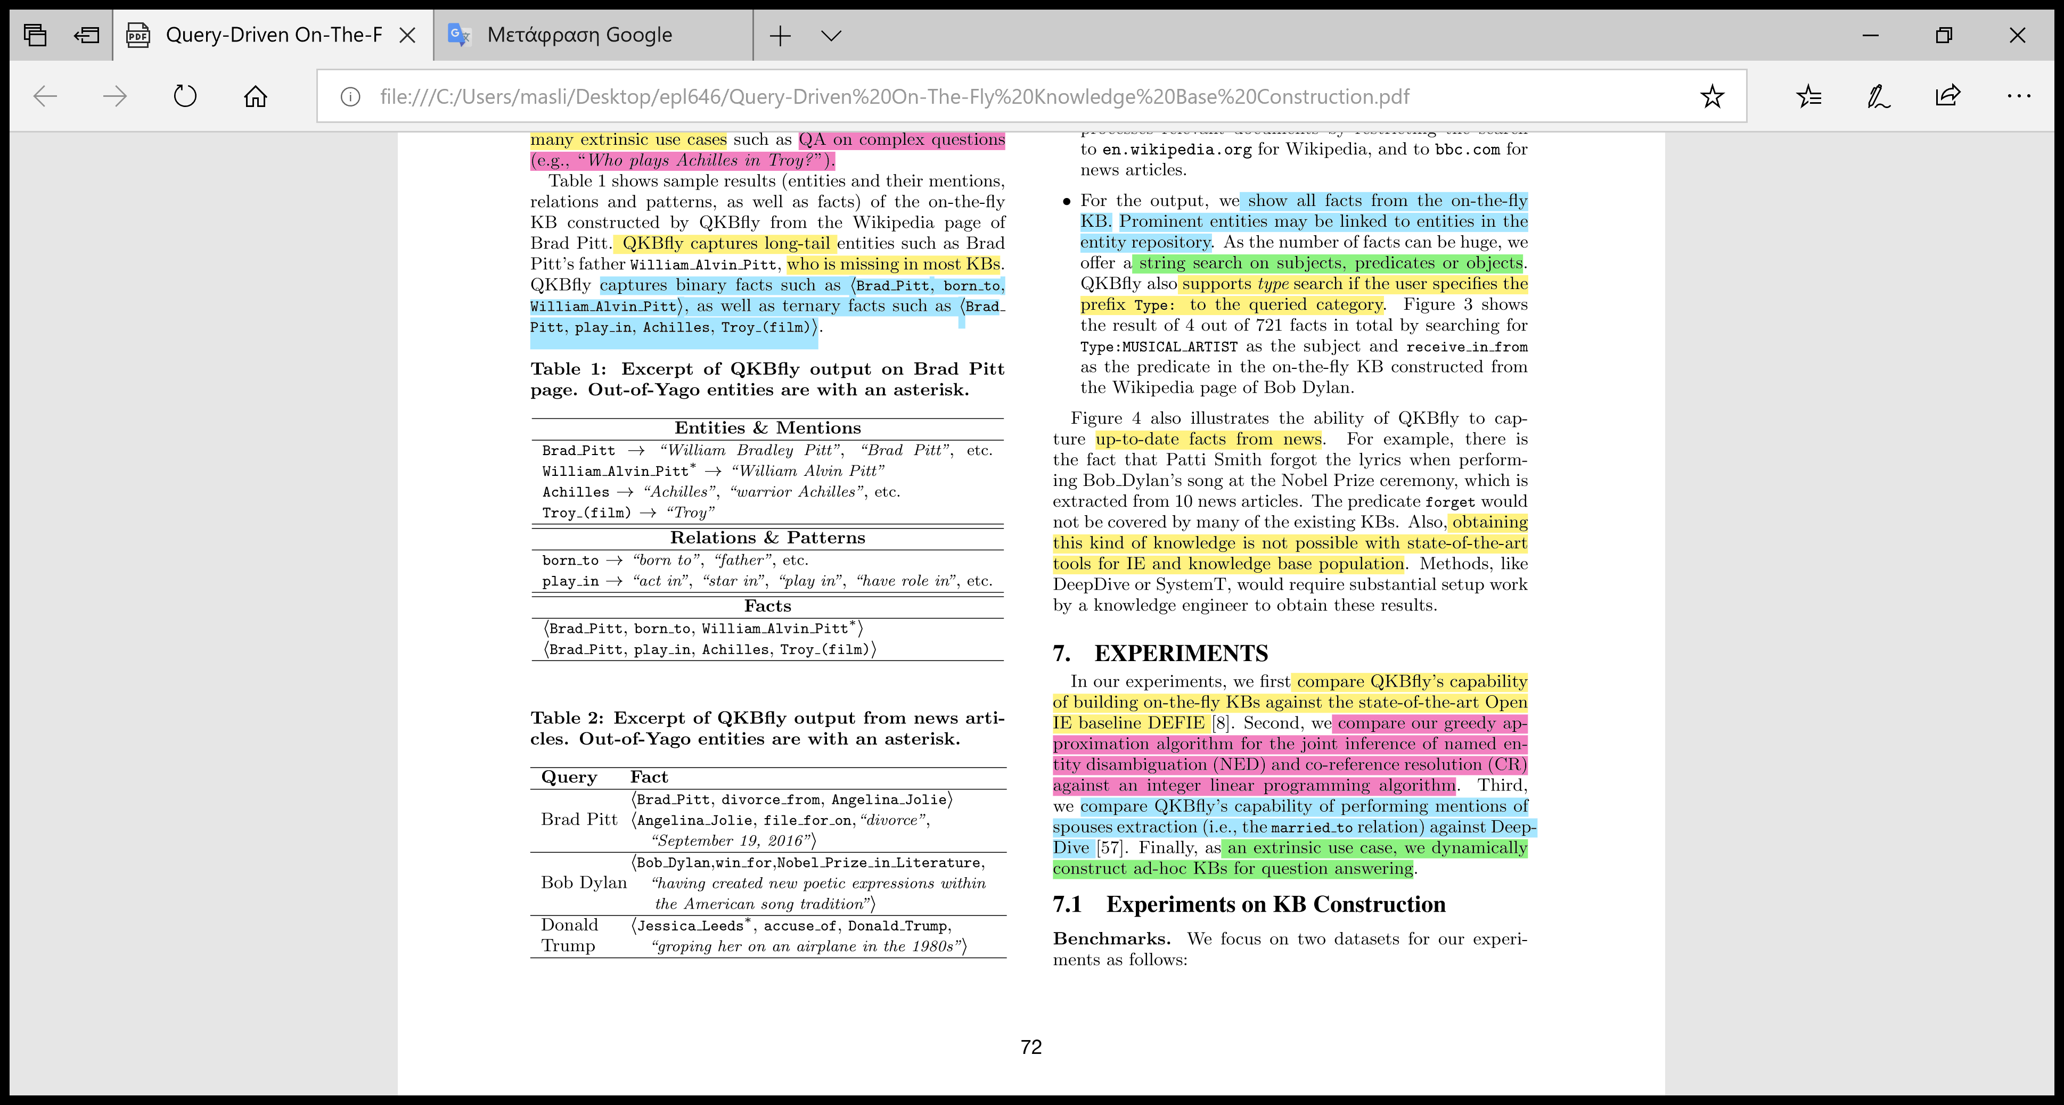
Examples
up-to-date knowledge
long-tail entity
emerging entity
ternary fact

Slide 27
Presentation Outline
Motivation
QKBﬂy Design
Semantic Graph
Graph Densification Algorithm
Canonicalization
Experiments
Conclusions and Future Work

Slide 28
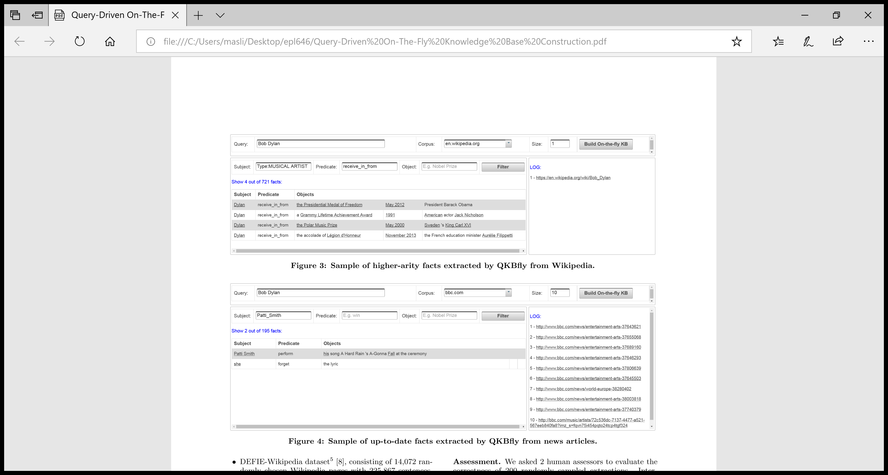
User Interface
User Query
Input Source (Wikipedia or news articles)
No. of source documents
Derived Facts
Fact Filtering

Slide 29
Up-to-date facts
Other KBs need manual setup to cover it

Slide 30
Experiments
On-the-ﬂy KB vs DEFIE[7]
Greedy approximation algorithm vs integer linear programming algorithm
QKBﬂy’s vs DeepDive[6] for spouses mentions
On-the-ﬂy KB for ad-hoc question answering

Slide 31
On-the-ﬂy KB vs DEFIE[7]
DEFIE-Wikipedia dataset [7]: 14,072 randomly chosen Wikipedia pages with a total of 225,867 sentences.
Reverb dataset [11]: 500 sentences (obtained by the random-link service of Yahoo).
Compare different configurations of QKBﬂy against DEFIE:
QKBﬂy joint fact extraction, NED and CR*
QKBﬂy-pipeline performs 3 stage fact extraction, NED and CR (type signature is omitted)
QKBﬂy-noun only performs fact extraction and NED (CR is omitted)
DEFIE: a pipeline architecture with two stages for NED (Open IE and Babelfy [12])
*named entity disambiguation (NED) and co-reference resolution (CR)
Notes:
Assessment. We asked 2 human assessors to evaluate the correctness of 200 randomly sampled extractions.

Slide 32
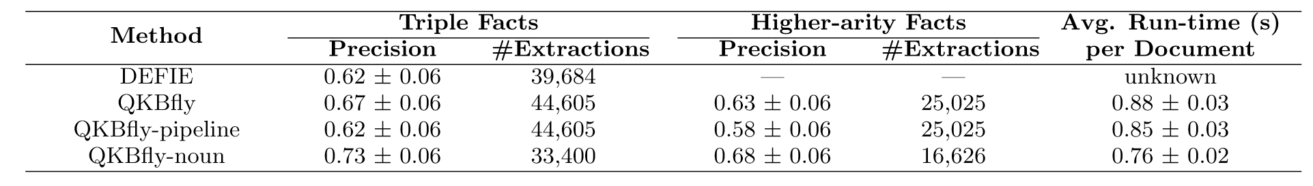
Results on Fact Extraction*
Conclusions:
QKBfly-noun has the better performance
QKBfly increases the number of extractions, having better precision and recall
QKBfly is runtime efficient thus scalable for processing large inputs on the fly
DEFIE is outperformed because it was optimized for short sentences (i.e. definitions) and fails to process complex text
DEFIE offers only fact triplets while QKBfly offers higher-arity facts too (captures more complex relations)
*on DEFIE dataset

Slide 33
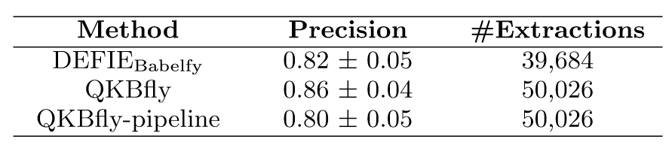
Results on Entity Disambiguation
Babelfy [12]: a graph based approach for NED. Word sense disambiguation based on a loose identiﬁcation of candidate meanings, coupled with a densest subgraph heuristic which selects high-coherence semantic interpretations (Since Babelfy does not consider pronouns, pronoun resolution is omitted).
Conclusions:
QKBﬂy gains 4% while QKBﬂypipeline loses 2% against Babelfy
Errors of QKBﬂy-pipeline and Babelfy coming from the missing type signature feature (e.g., Liverpool the city vs Liverpool F.C. the soccer club).
Notes:
We compare QKBﬂy variants to DEFIE/Babelfy on the NED sub-task: linking entities to the KB.

Slide 34
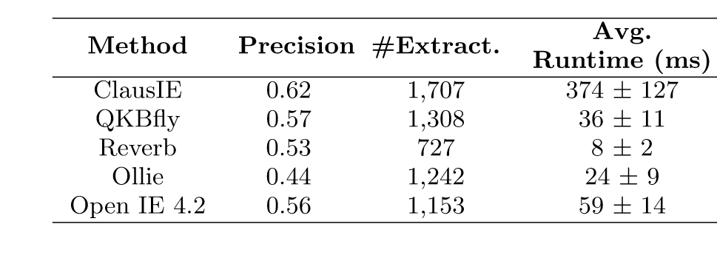
Results on Initial Extraction*
Conclusions:
ClausIE best precision and number of extractions, but it is the slowest method because it doesn’t provide output canonicalization.
Another reason for ClausIE being slower is that the other methods beneﬁt from using the MaltParser instead of the Stanford Parser.
The purely pattern-based Reverb (doesn’t use dependency parsing) is the fastest.
*on Reverb dataset
Notes:
We compare the Open IE component of QKBﬂy against state-of-the-art methods including the original work of ClausIE, Reverb [20], Ollie [35] and Open IE 4.27.

Slide 35
Experiments
On-the-ﬂy KB vs DEFIE[7]
Greedy approximation algorithm vs integer linear programming algorithm
QKBﬂy’s vs DeepDive[6] for spouses mentions
On-the-ﬂy KB for ad-hoc question answering

Slide 36
Greedy approximation algorithm vs integer linear programming algorithm
Additionally to the DEFIE dataset, two new datasets are used for this experiment:
News dataset: 100 sport news articles with 3,751 sentences extracted from more than 20 news websites (bbc.com, telegraph.co.uk, nytimes.com ,etc.).
Wikia dataset: 10 Wikia pages with 880 sentences about Game of Thrones, with text descriptions about the series episodes.
Compare QKBfly against QKBflu-ilp:
QKBﬂy, performs NED and CR with the greedy approximation algorithm
QKBﬂy-ilp, performs NED and CR with an Integer Linear Programming (ILP) approach (constraint problem with different types of weights and variables).
Notes:
We compare two conﬁgurations of QKBﬂy with different graph algorithms.

Slide 37
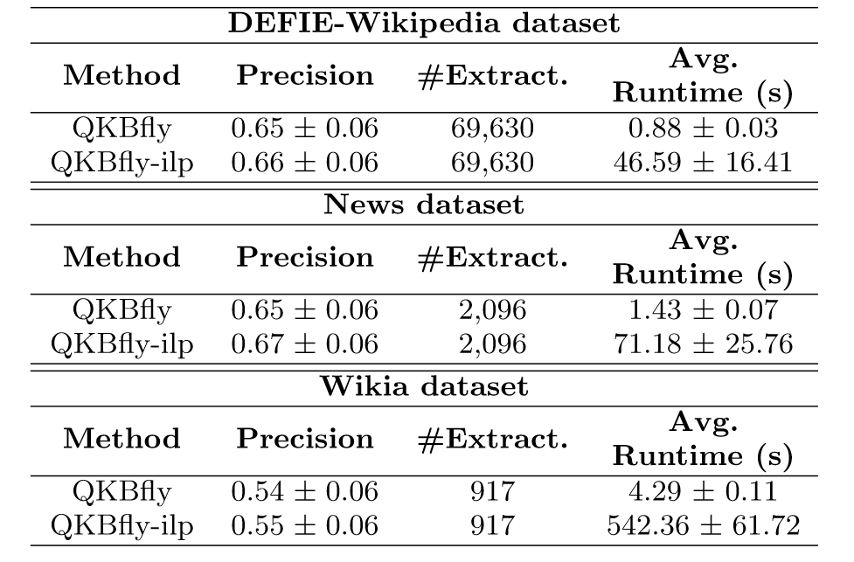
Results
Conclusions:
QKBﬂy-ilp gains 1%-2% in precision
QKBﬂy-ilp is much slower than QKBﬂy (especially for long documents). This is because QKBﬂy-ilp handles a very large number of variables in the ILP translation of the graph problem (less suitable for on-the-ﬂy KB construction).
QKBﬂy loses around 10% in precision when working on the Wikia since 71% of its entities are new (e.g. movie characters), while only 24% of the entities from the News and 13% DEFIE dataset are emerging.

Slide 38
Experiments
On-the-ﬂy KB vs DEFIE[7]
Greedy approximation algorithm vs integer linear programming algorithm
QKBﬂy’s vs DeepDive[6] for spouses mentions
On-the-ﬂy KB for ad-hoc question answering

Slide 39
QKBﬂy’s vs DeepDive[6] for spouses mentions
DeepDive [6]: provides a pre-conﬁgured extraction model for the marriage relation. Retrained with instances of married couples in Dbpedia (KB)[2] as positive examples into the DeepDive learner.
Compare QKBfly against DeepDive on a more traditional information extraction task on the DEFIE dataset (i.e. the instance extraction of the spouse relation).

Slide 40
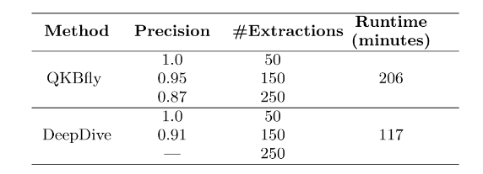
Results
Conclusions:
Both systems perform well at lower recall levels (50 extractions)
QKBﬂy outperforms DeepDive at higher recall levels.
DeepDive is twice as fast as QKBfly, but QKBfly always performs extractions for all relations (and co-reference pronoun resolution) opposing to DeepDive which cares only for the spouse relation.
A downside of DeepDive is the need for the manual setting of the model for each targeted relation.

Slide 41
Experiments
On-the-ﬂy KB vs DEFIE[7]
Greedy approximation algorithm vs integer linear programming algorithm
QKBﬂy’s vs DeepDive[6] for spouses mentions
On-the-ﬂy KB for ad-hoc question answering

Slide 42
On-the-ﬂy KB for ad-hoc question answering
Test QKBfly on a newly designed QA benchmark (“GoogleTrendsQuestions”). Using Google Trends service 50 recent events of wider interest were identified. Students were asked to formulate meaningful questions on these events and provide the gold-standard answers.
Compare different conﬁgurations of QKBﬂy against Freebase[5]:
QKBﬂy-triples: the on-the-ﬂy KB is limited to subject-predicate-object (SPO) triples.
Sentence-Answers: text-centric baseline. QKBﬂy is used to retrieve relevant sentences, but does not perform any fact extraction (no fact repository is available upfront). Entities in these sentences then become answer candidates. A type ﬁlter is applied on candidate answers to ensure the have the expected type(s) (e.g. questions starting with “Who” have answers of types PERSON, CHARACTER or ORGANIZATION). Each answer candidate is feeded to a pretrained binary classiﬁer (SVM). The positively labeled candidates are the ﬁnal answers.
QA-Freebase baseline: is a static KB where the same QA method is applied on the fact collection of Freebase.

Slide 43
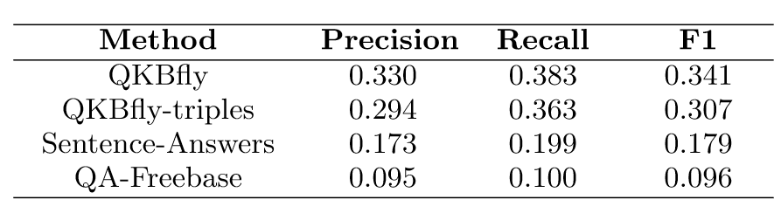
Results on the GoogleTrendsQuestions benchmark
Conclusions:
QKBﬂy achieves the best precision, recall and F1 score
QA-Freebase and Sentence-Answers perform far inferior. Particularly, QA-Freebase returns empty results in most cases due to the lack of facts about recent events (static KB).

Slide 44
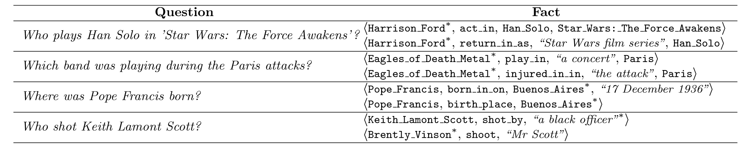
Example of event questions and returned facts
QKBﬂy performs better than QKBﬂy-triples in questions which require ternary facts, such as “Who plays Han Solo in ’Star Wars: The Force Awakens’?”.

Slide 45
Presentation Outline
Motivation
QKBﬂy Design
Semantic Graph
Graph Densification Algorithm
Canonicalization
Experiments
Conclusions and Future Work

Slide 46
Conclusions and Future Work
QKBﬂy: builds on-the-ﬂy knowledge bases in a query-driven manner.
A much larger set of predicates is acquired than those in mainstream KBs.
Facts are canonicalized.
Use cases for QKBﬂy: ad-hoc question answering, summarization and other kinds of machine-reading applications.
Improve the extraction speed and quality of the on-the-ﬂy KB output.
Apply on-the-ﬂy relational paraphrase mining.

Slide 47
References (1)
All figures were taken by the paper presented [1]
[1] Query-Driven On-The-Fly Knowledge Base Construction. Dat Ba Nguyen, Abdalghani Abujabal, Khanh Tran, Martin Theobald, Gerhard Weikum: 66-79, Volume 11, Number 1, September 2017, PVLDB 2017.
[2] DBpedia: A Nucleus for a Web of Open Data. S. Auer, C. Bizer, G. Kobilarov, J. Lehmann, and Z. Ives. In ISWC, pages 11–15, 2007.
[3] Yago: A Core of Semantic Knowledge. F. M. Suchanek, G. Kasneci, and G. Weikum. In WWW, pages 697–706, 2007.
[4] Wikidata: A Free Collaborative Knowledgebase. D. Vranděcíc and M. Krötzsch. CACM, 57(10):78–85, 2014.
[5] Freebase: A Collaboratively Created Graph Database for Structuring Human Knowledge. K. Bollacker, C. Evans, P. Paritosh, T. Sturge, and J. Taylor. In SIGMOD, pages 1247–1250, 2008.

Slide 48
References (2)
[6] DeepDive: Web-scale Knowledge-base Construction using Statistical Learning and Inference. F. Niu, C. Zhang, C. Re, and J. W. Shavlik. In VLDS, pages 25–28, 2012.
[7] Large-Scale Information Extraction from Textual Deﬁnitions through Deep Syntactic and Semantic Analysis. C. D. Bovi, L. Telesca, and R. Navigli. TACL, 3:529–543, 2015
[8] Open Information Extraction from the Web. M. Banko, M. J. Cafarella, S. Soderland, M. Broadhead, and O. Etzioni. In IJCAI, pages 2670–2676, 2007.
[9] ClausIE: Clause-based Open Information Extraction. L. Del Corro and R. Gemulla. In WWW, pages 355–366, 2013.
[10] PATTY: A Taxonomy of Relational Patterns with Semantic Types. N. Nakashole, G. Weikum, and F. Suchanek. In EMNLP-CoNLL, pages 1135–1145, 2012.
[11] Identifying Relations for Open Information Extraction. A. Fader, S. Soderland, and O. Etzioni. In EMNLP, pages 1535–1545, 2011.

Slide 49
References (3)
[12] Entity Linking meets Word Sense Disambiguation: a Uniﬁed Approach. A. Moro, A. Raganato, and R. Navigli. TACL, 2:231–244, 2014.

